Slide 1
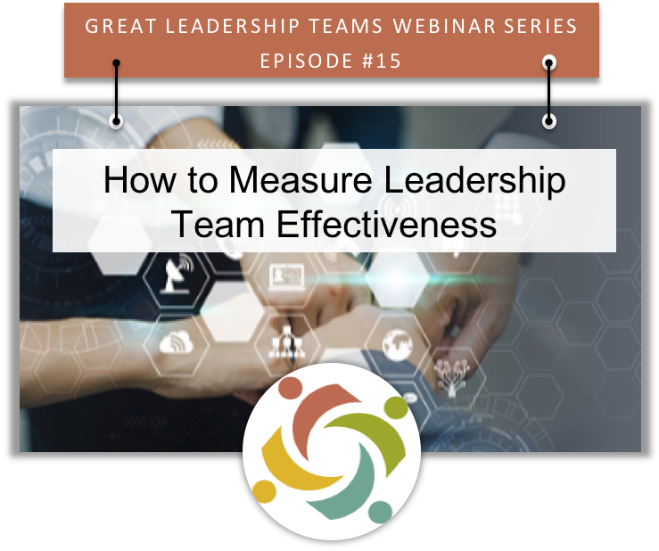

Slide 2
The Challenge
To build a great leadership team, CEOs have to help teams find the right balance between achieving results and maintaining a healthy culture.

Slide 3
Why is balance important?
Too Much Focus on Results…
Too Much Focus on Culture…
The best performing team in the world won't last very long if the team members don’t relate well. Individuals will seek out a better environment; so, any success the team enjoys will be short-lived.
A team that has a great culture but produces poor results isn't sustainable either. The company will lose money, and the team will eventually break up.

Slide 4
Great Leadership Team Characteristics
Oversee and contribute to the achievement of tangible, measurable results.
Have impact above and beyond the contributions of any one individual.
Grow in capacity to solve increasingly challenging problems over time.
Have confidence in their ability to get back in sync after inevitable periods of dysfunction.

Slide 5
Leadership Team Measurement Context
Stewardship of the Organization’s Strategic Direction
Achievement of a Specific Purpose at a Particular Point in Time
Continual Refinement of Foundational Structural and Relational Dynamics

Slide 6
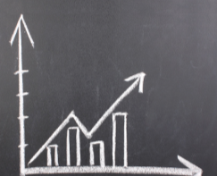
Measurement Perspectives
Much like measuring the performance of anything meaningful, measuring team effectiveness includes short and long term perspectives.
The long term view typically focuses on achieving tangible, measurable results – growth, productivity, etc.
The short term view typically focuses on areas that help predict the likelihood that long term results will be achieved or if adjustments are required.

Slide 7
A Predictive Measurement Model
Structural Factors
Relational Factors
Factors that help teams focus on and achieve specific business outcomes.
Factors that help teams develop productive and healthy work environments.
Helps Balance Results & Culture
Are the right people on the team?
Does the team operate by a set of agreed principles?
Do incentives support teamwork?
Does the team manage meetings well?
Do team members trust each other?
Does the team encourage diverging viewpoints?
Does the team engage in productive debate?
Do team members hold each other accountable?

Slide 8
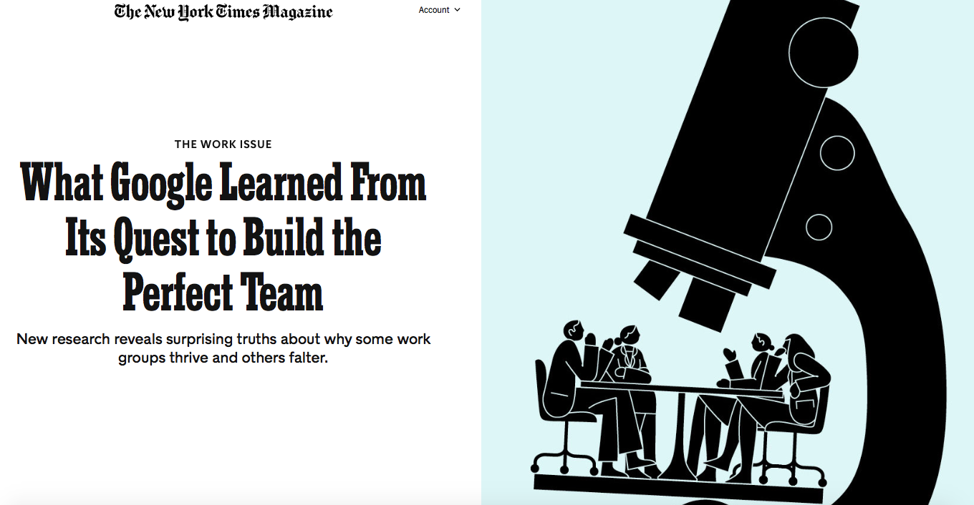
Google’s Team Effectiveness Model
"What really mattered was less about who was on the team, and more about how the team worked together," stated the researchers. Here is what matters most…
Psychological Safety
Dependability
Structure & Clarity
Meaning
Impact

Slide 9
A Proven Team Effectiveness Model
TCI’s Team Diagnostic Benefits...
Provides a baseline for improvement.
Focuses on both the structural and relational aspects of team performance.
Enables performance to be assessed from the perspectives of the team leader, team members and other stakeholders (i.e., internal customers, external partners, customers).
Use of a common and ‘everyday’ language that teams already use.
Passed statistical, psychometric standards for both validity and reliability.

Slide 10
TCI’s Team Diagnostic
TCI’s Team Diagnostic focuses on the Team as a System that has characteristics that transcend those of any one member.
The Team Diagnostic assesses team performance from two perspectives...
What results is the team achieving?
How is the team achieving these results?
Resources
Decision Making
Alignment
Accountability
Leadership
Goals and Strategies
Proactivity
Respect
Values Diversity
Camaraderie
Communication
Constructive Interaction
Optimism
Trust
Competencies that support the team’s ability to be productive
Competencies that create an environment that supports effective collaboration

Slide 11
TCI’s Team Diagnostic

Slide 12
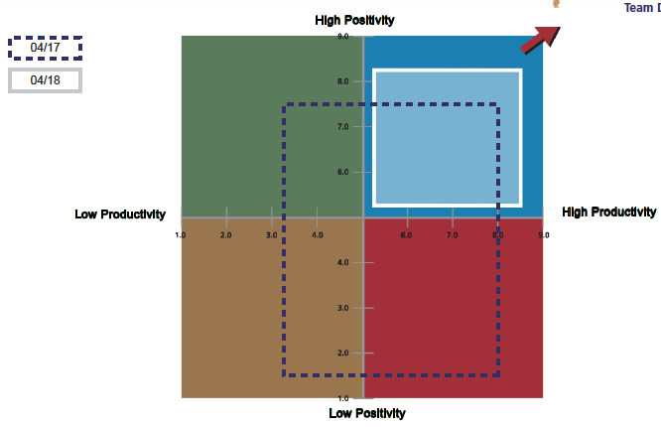
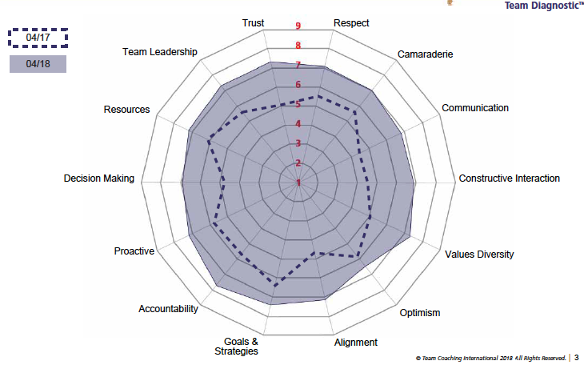
TCI’s Team Diagnostic
Team Diagnostic Period to Period Comparison Reports

Slide 13
Leadership Team Measurement Context
Stewardship of the Organization’s Strategic Direction
Achievement of a Specific Purpose at a Particular Point in Time
Continual Refinement of Foundational Structural and Relational Dynamics

Slide 14
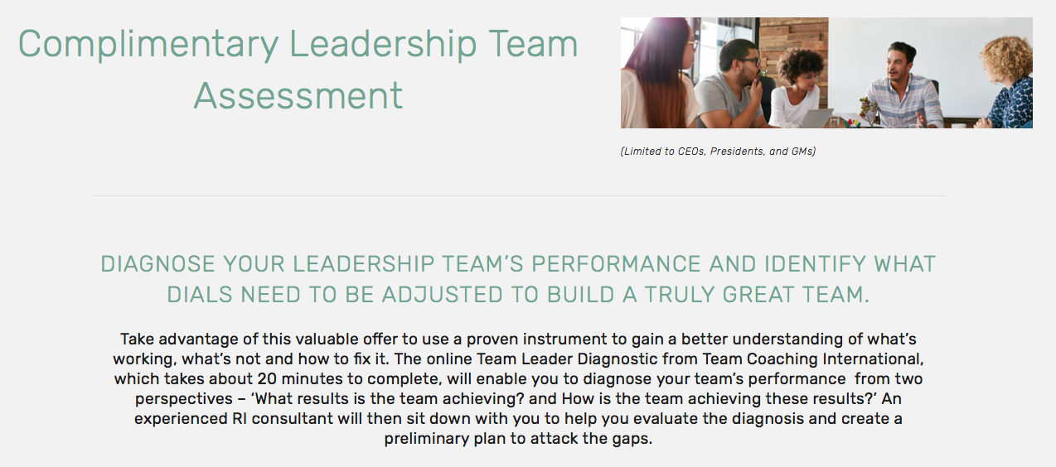
Complimentary Assessment
URL: www.relationship-impact.com/free-team-assessment/

Slide 15
Resources
What Google Learned from its Quest to Build the Perfect Team? https://www.nytimes.com/2016/02/28/magazine/what-google-learned-from-its-quest-to-build-the-perfect-team.html?smid=pl-share
Amy Edmonson TEDx Talk on Psychological Safety - https://www.youtube.com/watch?v=LhoLuui9gX8&feature=youtu.be

Slide 16
REGISTER

Slide 17
Relationship Impact, LLC www.relationship-impact.com
East Coast – Jack McGuinness
5905 Ramsgate Road
Bethesda, MD 20816
301-785-9731
jmcguinness@relationship-impact.com
West Coast – Gil Brady
700 Balboa Ave
Coronado CA 92118
703-431-7486
gbrady@relationship-impact.com

