Slide 2
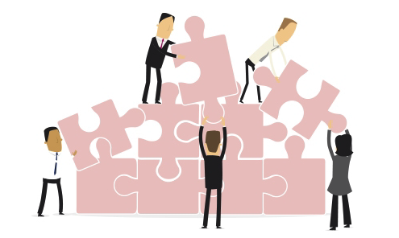
The Challenge
Diversity can be magical but given the natural variety of skills and styles on most leadership teams it is not surprising that they often face relational challenges that chip away at trust and diminish the team’s ability to engage in productive dialogue.

Slide 3
Behaviors & Assumptions
Your self-perception is based on…
Their perception of you is based on…
BEHAVIORS
BEHAVIORS - external
INTENTIONS
INTENTIONS
MOTIVATION
internal
MOTIVATION
…what you are trying to do.
…what they are seeing you do.

Slide 4
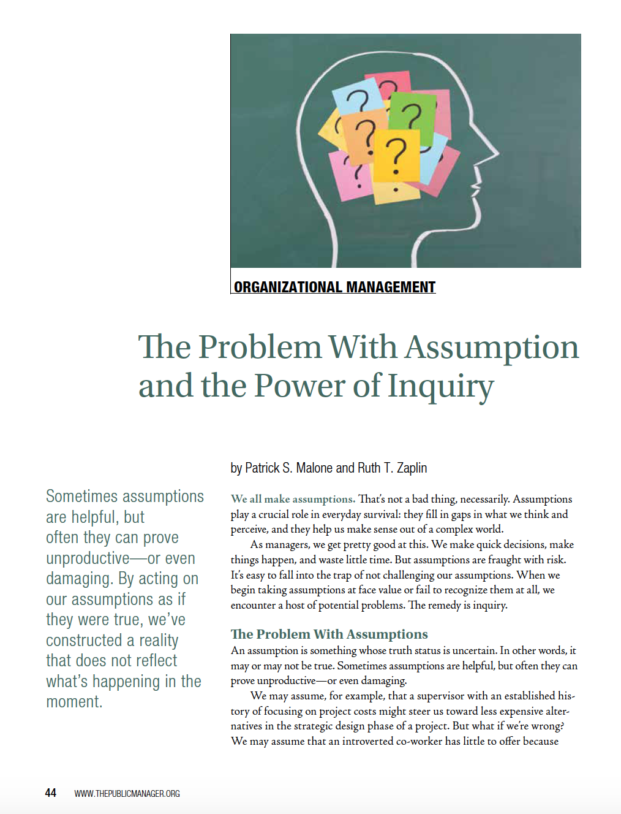
Assumptions
Assumptions fill in gaps in what we think and perceive, and they help us make sense out of a complex world.
But assumptions are fraught with risk. It’s easy to fall into the trap of not challenging our assumptions.
When we begin taking assumptions at face value or fail to recognize them at all, we encounter a host of potential problems.
Click on image to access article.

Slide 5
The Problem with Assumptions
“Sometimes assumptions are helpful, but often they can prove unproductive—or even damaging. By acting on our assumptions as if they were true, we’ve constructed a reality that does not reflect what’s happening in the moment.” (Patrick Malone & Ruth Zaplin)

Slide 6
Assumption Cycle
Executives often struggle to make sense of their colleagues’ behaviors; especially ones that are foreign to them.
In an attempt to make sense they often make assumptions about these behaviors which are often wrong.
Unfortunately, unchecked assumptions often lead to ineffective reciprocal behavior.
These types of reactions lead to a tacit escalation of conflict which is most often expressed passive aggressively and with behind the scenes lobbying.
Escalation
Reciprocal Behavior
Assumption
Behavior
He doesn’t listen very well.
He only cares about his viewpoint.
I will stop raising issues when he is in the room.
Our departments don’t work well together.

Slide 7
Move Beyond Assumptions
BE PROACTIVE
Great leadership teams step back and get to know each other.
They inquire about each other’s technical approaches and experience.
They work to appreciate the things that motivate each other at work and beyond.
They dig deep to understand the behavioral adaptations each must make to be great team members.

Slide 8
Move Beyond Assumptions
BE CURIOUS
The anecdote to unchecked assumptions is inquiry.
Curiosity about a behavior that seems odd, annoying or disturbing can lead to new realities.
When we are curious, we view tough situations more creatively and have fewer defensive reactions to stress.
Edgar Schein calls this humble inquiry or asking questions to which you don’t already have the answer.

Slide 9
Move Beyond Assumptions
BE THE ADULT IN THE ROOM
When a teammate is down or unaware, their colleagues step up and help them out; they become the adult in the room.
Team members react first by assuming good intentions and work diligently to read each tense or difficult situation.
When teams are laser focused on what’s most important, they tend to rise above the natural relational challenges that exist on the best of leadership teams.

Slide 10
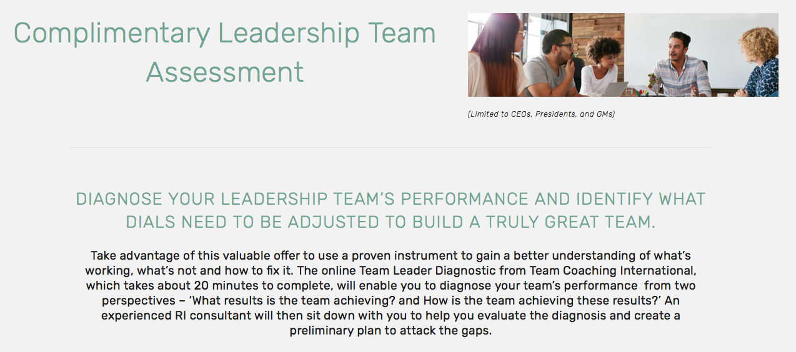
Complimentary Assessment
URL: www.relationship-impact.com/free-team-assessment/

Slide 11
REGISTER for January 22nd Webinar

Slide 12
Relationship Impact, LLC www.relationship-impact.com
East Coast – Jack McGuinness
5905 Ramsgate Road
Bethesda, MD 20816
301-785-9731
jmcguinness@relationship-impact.com
West Coast – Gil Brady
700 Balboa Ave
Coronado CA 92118
703-431-7486
gbrady@relationship-impact.com

