Slide 2
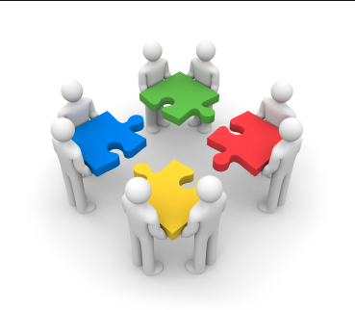
Great Teams Exercise
‘It’s was all about trust as we always had each other’s backs even when things didn’t go so well.’
‘The path wasn’t always crystal clear, but we all knew where we were headed and were confident that we could get there.’
‘Everyone pulled their weight; we just didn’t want to let each other down.’
‘When we screwed up, we didn’t point fingers; we just fixed the problem and did our best to not mess up again.’

Slide 3
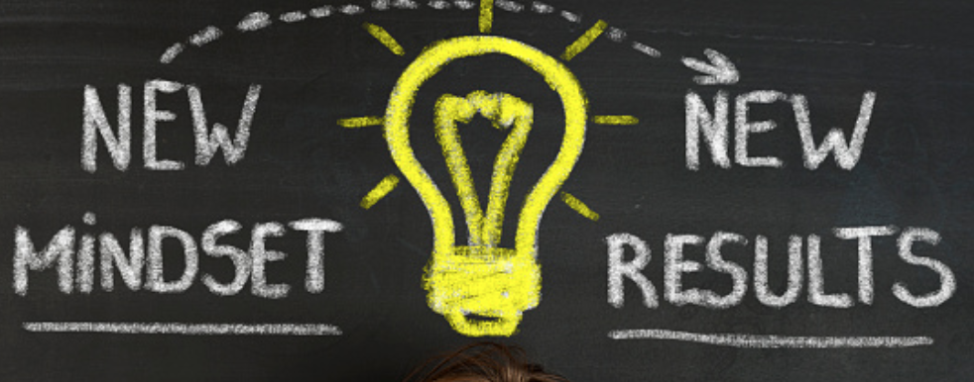
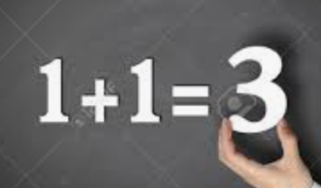
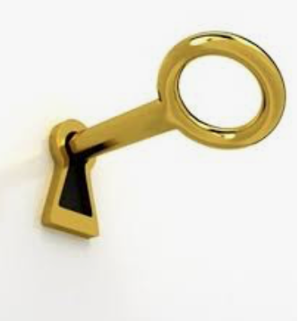
4 Features
Results Focus
Force Multiplier Effect
Manage Complexity
Resilience

Slide 4
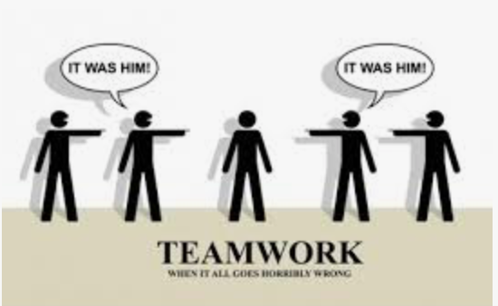
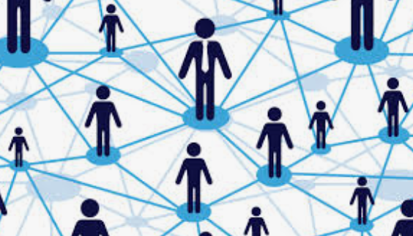
Results Focus
Why is it that so many leadership teams take their eye off the ball and let seemingly trivial issues or lack of discipline get in the way?
Ineffective Relational Dynamics
Poor Structural Dynamics
Acknowledge → Reflect → Commit
Notes:
I see a colleague behave in a manner I don’t appreciate. I then make an assumption about this behavior – e.g., lazy, arrogant, unbending. The behavior becomes frustrating, so I confront my colleague and he gets defensive. I then come to the conclusion that I don’t trust my colleague. We then settle into a pattern of avoidance, lashing out and more assumptions.

Slide 5
Force Multiplier Effect
Great leadership teams recognize that their true value lies in the unique and complementary talents that individuals bring to the team and their ability to harness these talents in the interest of a common purpose.
Complimentary Skills
Common Purpose
Shared Behaviors

Slide 6
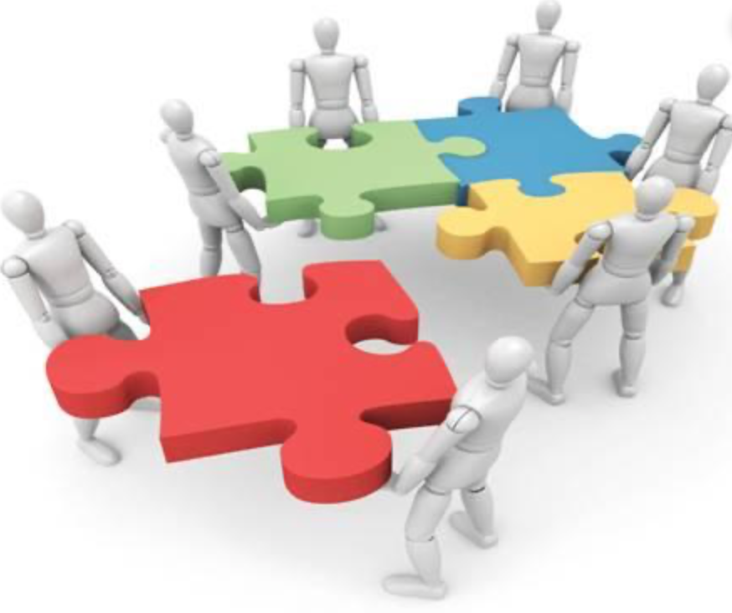
Manage Complexity
“Great leaders have a greater capacity to live with the anxiety of not knowing and not being in control while interacting creatively and productively.”
Great at Integrating Roles
Truly Understand What Trust Means

Slide 7
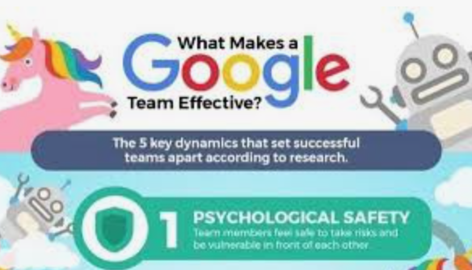
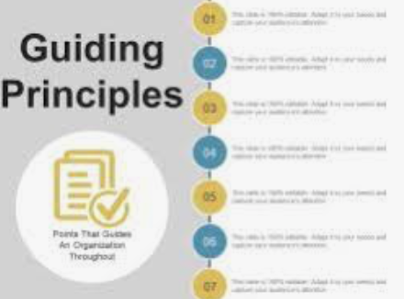
Resilience
“No battle plan survives first contact with the enemy.”
Great leadership teams have confidence in their ability to get back in sync after inevitable periods of challenge and dysfunction.
Greater Good Mindset
Psychological Safety
Operating Principles

Slide 8
Final Thoughts
Leadership teams are an important vehicle for enabling their organizations to thrive.
Great teams accelerate the performance of the organizations they lead but at times they can get in their own way and can hold back progress.
The best teams have established the fiber between members that helps them focus on the 4 features.

Slide 9
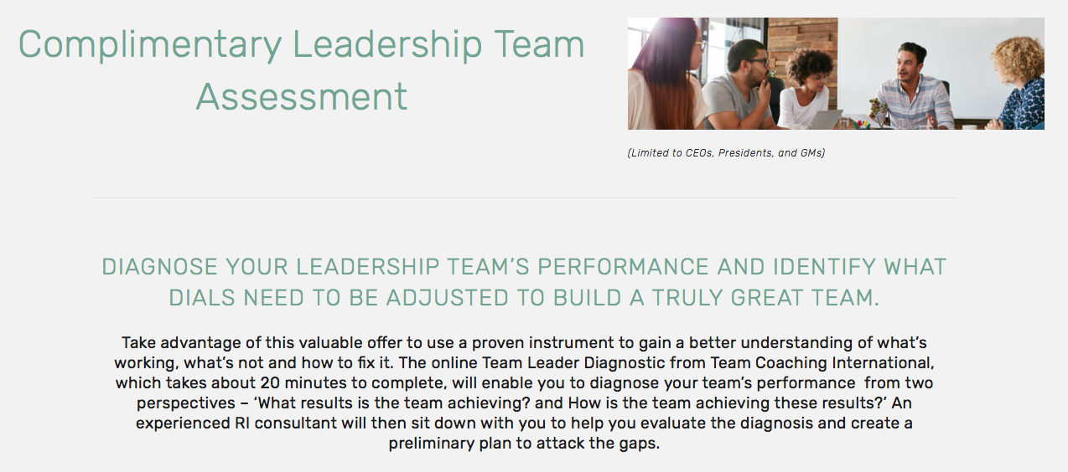
Complimentary Assessment
URL: www.relationship-impact.com/free-team-assessment/

Slide 10
REGISTER for February 26th Webinar

Slide 11
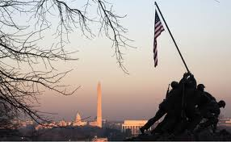
Relationship Impact, LLC www.relationship-impact.com
East Coast – Jack McGuinness
5905 Ramsgate Road
Bethesda, MD 20816
301-785-9731
jmcguinness@relationship-impact.com
West Coast – Gil Brady
700 Balboa Ave
Coronado CA 92118
703-431-7486
gbrady@relationship-impact.com

