Slide 2
Brute Force Leadership Teams
Some leadership teams are great at operating in a crisis regardless of how dysfunctional they are normally.
One of our clients refers to this mode of operating as ‘brute force leadership’…
”We just rise to the challenge and rally around a common goal and use our collective talents and experience to make progress.”

Slide 3
Brute Force Leadership Teams
Day-to-day these teams are out of sync…
disagreements turn into petty battles,
unit silos are reinforced,
unhealthy coalitions are formed, and
individuals make commitments they have no intention of keeping.

Slide 4
Brute Force Leadership Teams
When faced with a significant crisis (often the result of their dysfunction) such as challenges with closing on a new acquisition, implementing an enterprise system, or launching a new product, they embrace the challenge and don’t let dysfunction get in the way.
These leadership teams…
get focused on what is most important,
figure out what needs to be done and how to do it, and
secure the resources and work the hours necessary to reach the goal.

Slide 5
The Challenges
By its very nature operating in crisis mode is physically and emotionally draining.
For each new crisis, leadership teams must create new processes, relearn how their teammates operate, and commit intense time and energy.
As organizations scale the challenges that leadership teams face become more complex…
more employees and vendors involved, more customers impacted, and more dollars at stake.

Slide 6
Tapping Into the Hidden Reserve
Set aside the unproductive characteristics…
Stop avoiding the tough conversations that result in pushing the proverbial can down the road.
Stop behaving as if time and use of resources come in unlimited quantities.
Notes:
First, avoiding tough conversations results in pushing the proverbial can down the road. Issues that could be resolved early on through debate and compromise are pushed to a tipping point where a decision has to be taken. Next, behaving as if time and use of resources come in unlimited quantities is perhaps one of the biggest contributors to burnout and turnover. Rather than coalescing around a plan of attack brute force teams rely on their ability to react. Teams simply dig in and dedicate additional time and require employees to participate in their reactive, firefighting approaches.

Slide 7
Tapping Into the Hidden Reserve
Adopt positive crisis management characteristics…
Rally around a common goal.
Put personal issues aside and stay focused on what’s most important
Team members must listen to each other and compromise.
Notes:
This focus on a specific common purpose gives leadership team members a strong sense of what work they need to do together and what work is simply part of their functional responsibility.
Next, brute force leadership teams put personal issues aside, stay focused on what’s most important and recognize that to be successful they have to rely on the diverse talents and experience of each team member.
Finally, effective crisis management requires team members to listen to each other and compromise. While team members might not enjoy this important skill at the time, they realize that it is required to push time sensitive, complex initiatives forward.

Slide 8
Improve Productive Dialogue
Repairing relational fibers among teammates is critical.
Check assumptions; they are often wrong.
Suspending judgement as it helps to repair trust.
Start the hard work with “me” not why everyone is so wrong.
When trust improves teams challenge, debate and disagree more productively.
Notes:
Over time brute force leadership teams tend to chip away at the relational fibers among teammates. To start the hard work of strengthening these fibers each team member has to suspend judgement and evaluate the assumptions they are making about their teammates (i.e., ‘he doesn’t hold his unit accountable’; ‘she doesn’t work hard’; ‘he doesn’t care what anyone else thinks’). Assumptions are often wrong and are created based on how teammates see their colleagues behave rather than understanding their intentions and motivations. Suspending judgement also helps to repair trust as teammates begin to get to know each other at a deeper level. When this happens, trust begins to improve which enables teams to challenge, debate and disagree more productively.

Slide 9
Strengthen Structural Foundation
As leadership teams are more comfortable challenging and disagreeing, they can begin to build an effective structural base.
Leadership teams must engage in the sometimes-difficult discussions about how to best integrate team member roles.
Establish behavioral expectations for how they will operate together.
Notes:
First, leadership teams have to engage in the sometimes-difficult discussions about how to best integrate team member roles – who has the lead, how will information be shared, how are conflicts resolved. Productive role integration discussions can help squash the often-incorrect assumptions team members make about each other. Next, to gain consistency and build an accountability foundation great leadership teams need to establish behavioral expectations for how they will operate together. Principles that emerge from managing in a crisis might include – listen and compromise, receive feedback well, and resolve issues directly.

Slide 10
Final Thoughts
Acknowledge that brute force leadership is not sustainable.
Focus on both sides of the Great Leadership Teams Coin…
Listen and Compromise
Ensure Effective Integration

Slide 11
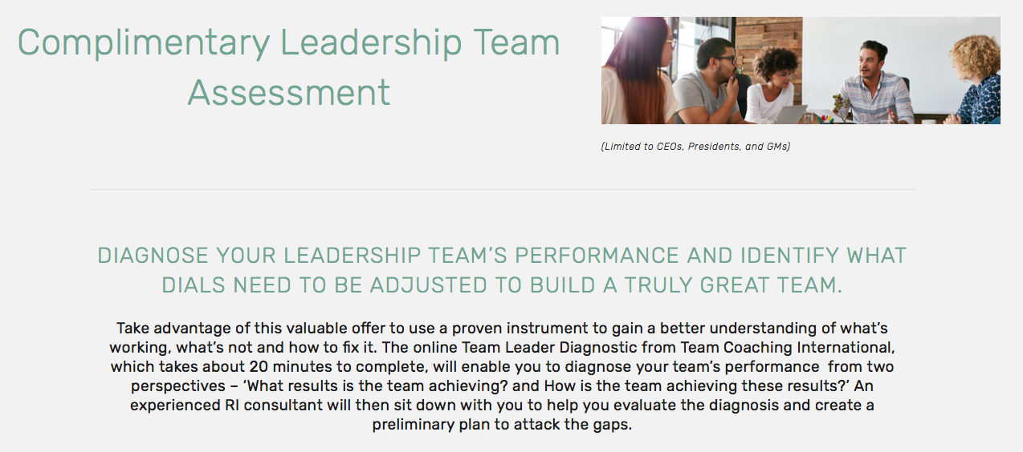
Complimentary Assessment
URL: www.relationship-impact.com/free-team-assessment/

Slide 12
REGISTER for March 25th Webinar

Slide 13
Relationship Impact, LLC www.relationship-impact.com
East Coast – Jack McGuinness
5905 Ramsgate Road
Bethesda, MD 20816
301-785-9731
jmcguinness@relationship-impact.com
West Coast – Gil Brady
700 Balboa Ave
Coronado CA 92118
703-431-7486
gbrady@relationship-impact.com

