Slide 1
Today’s webinar will start in a few minutes.

Slide 2
The Challenge
Poor expectations hands down the most frustrating quality they have experienced in their managers.
Only about half of all workers strongly indicate that they know what is expected of them.

Slide 3
A few scenarios…
Kick the Can Down the Road
Faulty Assumptions
Pulling Back on Overdone Incentives
Isn’t it Obvious?
Notes:
Kick the can down the road. Early on a founder and her key principals worked hard to build a successful firm. The founder told the principals not to worry “I’ll take care of you” and she truly meant it, but she really had no idea what ‘take care of you’ meant. The firm was wildly successful and when the founder finally stepped back to create a solution, it fell way short of their expectations.
You know what they say about assumptions! A CEO and marketing VP agreed that it would be important to have a customer panel at their upcoming industry conference. The VP and her team worked for several months to build a great event including what they thought was an innovative customer panel. The day before the conference the CEO ripped into the marketing VP for ‘the stupid’ way she set up the panel.
You’re taking what away? A founder and her principals were wildly successful in their first few years in business and the founder was quite generous with perks – large bonuses, club memberships, paid family trips, company cars, among others. The company continued to grow, and the founder became frustrated with a lopsided salary (and perks) structure that was making it difficult to invest and hire other talented people. Her discussions with the principals to revamp the executive compensation structure were not well received.
Isn’t it obvious? Many executives were concerned about what they felt was a lack of strategic direction, but the CEO’s consistent response was ‘our strategy is to grow in a manner consistent with our values.’ He often commented ‘I shouldn’t have to tell you; it should be obvious.’

Slide 4
Root Cause #1 - Lack of Discipline
Unclear/Shifting Priorities. It is difficult to establish clear expectations when strategy and related priorities are not well defined or when priorities are constantly shifting.
Inadequate assumptions. We often observe leadership team members act on important initiatives without stepping back even just briefly to ensure they are in alignment.
Notes:
Shifting priorities: We are working with one CEO who has led the successful growth of his company on intuition and hard work. However, the company recently went public, and his span of responsibility grew significantly. As a result, his team of talented individual contributors is struggling - what is most important? who is responsible for which cross-organizational initiatives? how do we prioritize limited resources? – which is causing infighting and creating serious inefficiencies.
Assumptions: They make assumptions about expected outcomes, who is going to do what by when, and other important factors. Sometimes the stars align, and their views are in sync but many times they are not, and chaos ensues. One client CEO was concerned about a customer concentration issue, so all three of her business line leads took the initiative (separately) to attack the issue and their teams wound up calling on the same customers with different pitches.

Slide 5
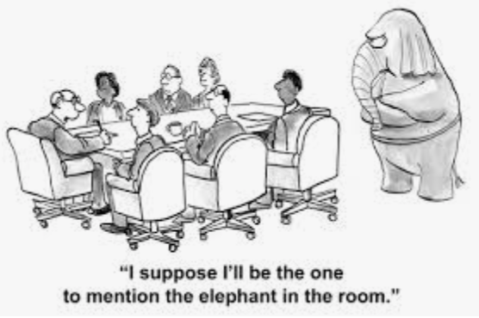
Root Cause #2 - Avoidance
Tension is natural but executives tend to avoid tension as they simply do not like conflict, difficult conversations or disagreement.
Avoidance behavior is manifested when executive teams fail to discuss, debate and gain clarity on the natural overlaps between their roles.
When executives ‘kick the can down the road’ about issues like compensation, ownership, or promotions frustration brews and trust begins to erode.
Notes:
Lack of productive dialogue. For example, without clarity faulty assumptions are often made about the obvious grey areas between product development and operations, investor relations and marketing, customer service and fulfillment, and many others.
We have observed CEOs destroy once productive relationships by making pseudo promises like ‘don’t worry I will take care of you’. There are usually good intentions behind these statements but as time passes the expectation gap often widens – i.e., ‘you are only giving my X% ownership?’

Slide 6
Impact Spectrum
Frustration
Trust Erosion
Performance Degradation
Cascading Effect
Notes:
Teammates on unhealthy teams are much more likely to let their individual frustration grow while at the same time avoiding the often-difficult discussions necessary to resolve frustration. Unfortunately, the longer it lasts the greater the likelihood that the impacts of frustration will be significant. A typical avoidance scenario looks like this – teammates avoid having tough discussions, they talk negatively about each other to others, they directly or indirectly undermine colleagues with whom they are at odds, the situation gets out of control and the CEO has to step in to help temper the situation. Often times the issue at hand is resolved in the short term but the seeds of dysfunction are sown for the longer term. Trust among teammates which is extremely hard to rebuild is degraded. The team continues to miss the opportunity to learn how to disagree and challenge each other productively. Managers and staff observe how the leadership team functions together and negative behaviors (avoidance, passive aggressiveness, hiding information) tend to cascade throughout the organization. Most importantly, time and attention are deviated from what is most important – customer service, operational efficiency, innovation.

Slide 7
“The Avoidance Dance”
A typical avoidance scenario looks like this…
teammates avoid having tough discussions,
they talk negatively about each other to others,
they directly or indirectly undermine colleagues with whom they are at odds,
the situation gets out of control and
the CEO steps in.

Slide 8
What to do…
BE DISCIPLINED!
&
DON’T AVOID!

Slide 9
Recalibrate
Acknowledge
Agree to Principles
Set Strong Relational Foundation
Execute & Monitor
Notes:
Step 1 – Acknowledge the Challenges: Not unlike most difficult challenges, acknowledgment is critical. Leadership teams and individual team members must acknowledge the impacts and take responsibility for any failure to establish clear expectations. Acknowledgement should be forward looking and used a mechanism for learning and adjusting course.
Step 2 – Agree to a Few Principles: In order to build an environment where clear expectation setting becomes standard practice, leadership teams should establish and begin to model a few foundational principles.
Step 3 – Build a Strong Relational Foundation: As mentioned above the impacts of ambiguous expectations can chip away at trust and hinder the ability of individuals and teams to engage productively. Principles can be established and time on agendas can be allocated but little will change without doing the hard work necessary to rebuild trust and have productive conversations. (use these links to access our previous articles on building trust and strengthening productive dialogue)
Step 4 – Execute and Monitor: Begin to model the principles and leverage stronger relationships to get clear on what the parties are expecting from each other. Periodically step back and monitor progress so that expectations can be recalibrated as new information emerges or the environment changes.

Slide 10
Example Principles
Make the implicit, explicit.
Both parties have a responsibility for clarity.
Expectation setting should be a 2-way discussion.
Link expectations to key priorities.
Notes:
Both parties have a responsibility for clarity – e.g., if the receiver is not clear it is his/her responsibility to ask questions to gain clarity.
Expectation setting should be a 2-way discussion between the parties involved with a willingness to listen to potential constraints or challenges.
Link expectations to key priorities so that the parties involved can better understand why the expectations are necessary.

Slide 11
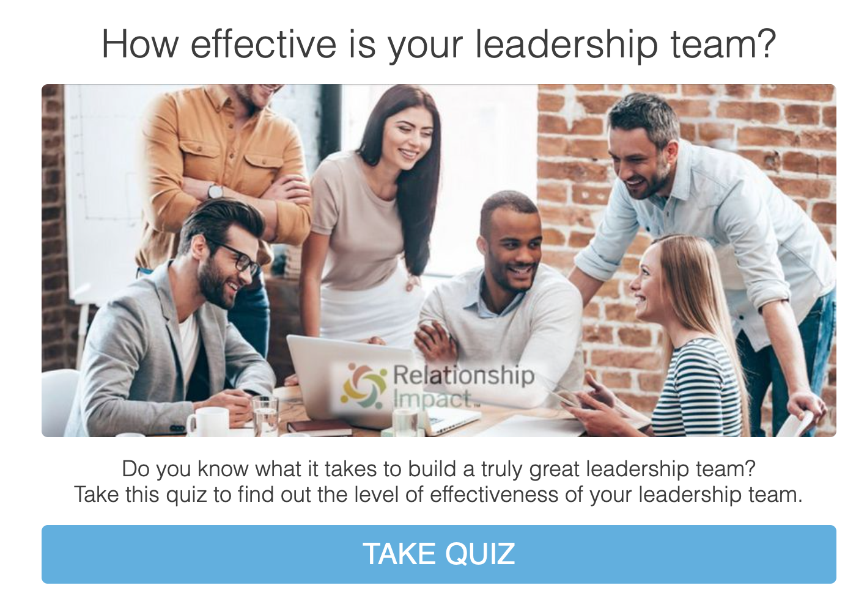
Complimentary Assessment

Slide 12
REGISTER for April 29th Webinar

Slide 13
Relationship Impact, LLC www.relationship-impact.com
East Coast – Jack McGuinness
5905 Ramsgate Road
Bethesda, MD 20816
301-785-9731
jmcguinness@relationship-impact.com
West Coast – Gil Brady
700 Balboa Ave
Coronado CA 92118
703-431-7486
gbrady@relationship-impact.com

