Slide 1
The webinar will start in a few minutes…

Slide 2
Some research…
CEO one-on-one discussions with direct reports can have a surprisingly large impact on a leadership team’s performance.
Project Oxygen Study
State of the American Manager
Higher scoring managers are more likely to have frequent one-on-one meetings with direct reports.
Employees who have regular one-on-ones are 3X more likely to be engaged and thrive at work.

Slide 3
The research makes logical sense…
Relationships are built on trust and trust requires time, give and take, and vulnerability.
And just like with any good habit – think exercise and dieting – getting our desired results requires practice and repetition.
Executive relationships are no different and one-on-one discussions can be a very useful tool for accelerating and helping them thrive.

Slide 4
Many executives think 1-on-1s are unproductive…
“We start with good intentions but inevitably we default to putting out the latest fire or resolving a specific tactical issue.”
“He (CEO) tends to dominate the discussion with complaints which might be related to what’s most important to me but often are not.”
“My direct reports rarely come prepared with substantive discussion points and I have to carry the meeting.”
“I leave these discussions with little to no sense about how I am doing and what I could be doing to get better.”
“I feel like she (CEO) is doing these one-on-one’s because HR told her to as she is often not very engaged or attentive.”

Slide 5
1-on-1s can be a powerful tool…
Help solidify or course-correct strategic direction.
Help executives become better teammates and leaders.
Serve as an early warning for a host of potential challenges and obstacles.
“One-on-ones are where you can ask strategic questions such as, are we focused on the right things? And… they show direct reports that you value and care about them.”

Slide 6
Effective 1-on-1s should accomplish 3 things…
Clarify Expectations
Address Priorities
Demonstrate Support

Slide 7
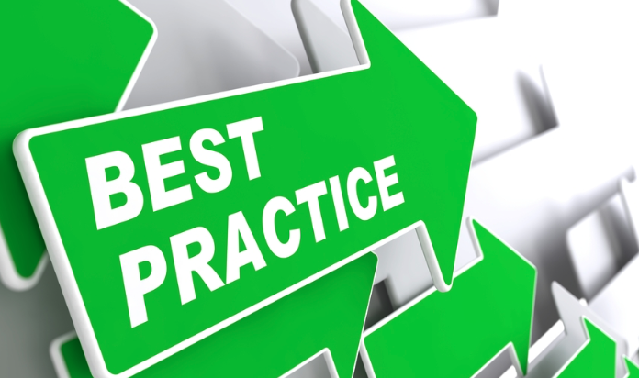
1-on-1 Best Practices…
Don’t wing it!
Don’t put it all on your direct reports.
Stay focused on what is most important; technically and developmentally.
Be attentive.
Don’t substitute.

Slide 8
Leadership Team Recharge Consultation
Learn More

Slide 9
REGISTER for September 23rd Webinar

Slide 10
Relationship Impact, LLC www.relationship-impact.com
East Coast – Jack McGuinness
5905 Ramsgate Road
Bethesda, MD 20816
301-785-9731
jmcguinness@relationship-impact.com
West Coast – Gil Brady
700 Balboa Ave
Coronado CA 92118
703-431-7486
gbrady@relationship-impact.com

